Slide 1

Introduction to Computer Science: Programming Methodology
Tutorial 14
tree
Frederick Khasanto
122040014
7 December 2023

Slide 2
Definition of Binary Tree Class
Refer to the LBTree.py file.
The nodes in the binary tree you define is of Node class defined by yourselves. Node class has four data fields, one(element) store the value of the node and three references(or pointers) store parent, left child and right child node respectively(or equivalently their addresses).
The binary tree has two data fields, its root and its size(the total number of nodes).

Slide 3
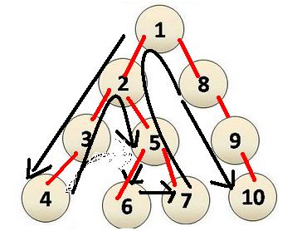
Depth First Search
Refer to the DFS.py file.
Depth-first search (DFS) is a fundamental algorithm for traversing or searching tree data structures.
One starts at the root and explores as deep as possible along each branch before backtracking.

Slide 4
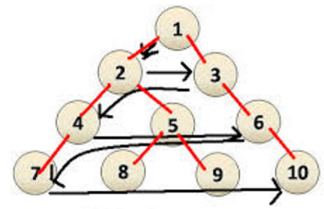
Breadth First Search
Refer to the BFS.py file.
Breadth-first search (BFS) is another very important algorithm for traversing or searching tree data structures.
Starts at the root and we visit all the positions at depth d before we visit the positions at depth d +1.

Slide 5
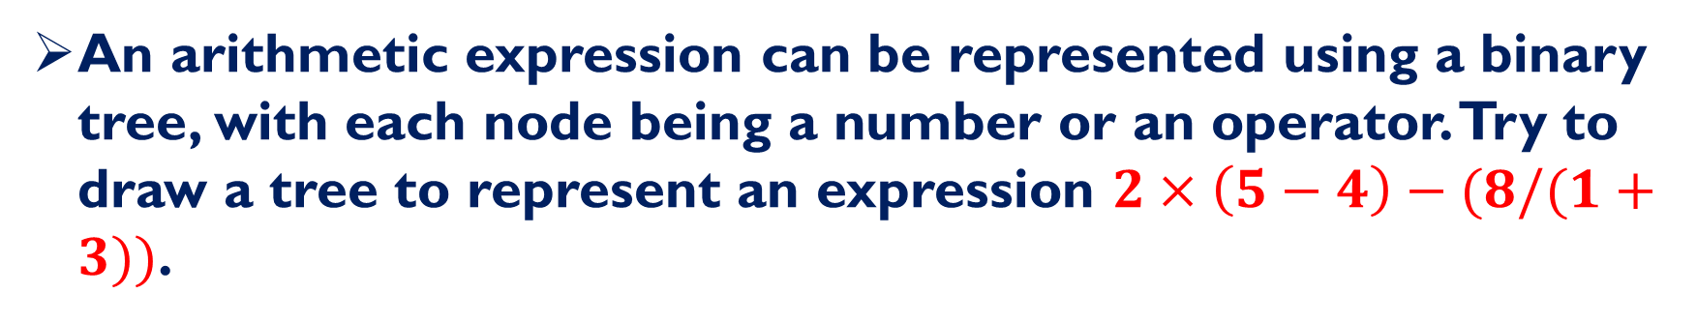
Q1: Represent an Expression
An arithmetic expression can be represented using a binary tree, with each node being a number or an operator. Try to draw a tree to represent an expression $2×\left(5−4\right)−(8/(1+3))$.

Slide 6
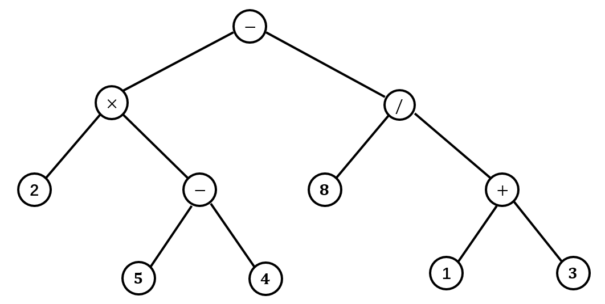
Q1: Answer

Slide 7
Q2: Create a Tree Object
Using the definition of binary tree class, create an object of that class, with value of each node equal to that in the binary tree you draw in Q1.

Slide 8
Q3: Depth First Search
i) Apply the Depth First Search algorithm to the tree you create in Q2, and check the order of elements in the tree printed out.
ii) Modify the Depth First Search program a little bit, define a function that is able to evaluate an expression represented by a binary tree.
iii) You can try i) ii) using Breadth First Search algorithm.

Slide 9
Q4: Path Length of a Tree-I
The path length of a tree T is the sum of the depths of all positions in T. Describe a linear time method for computing the path length of a tree T.

Slide 10
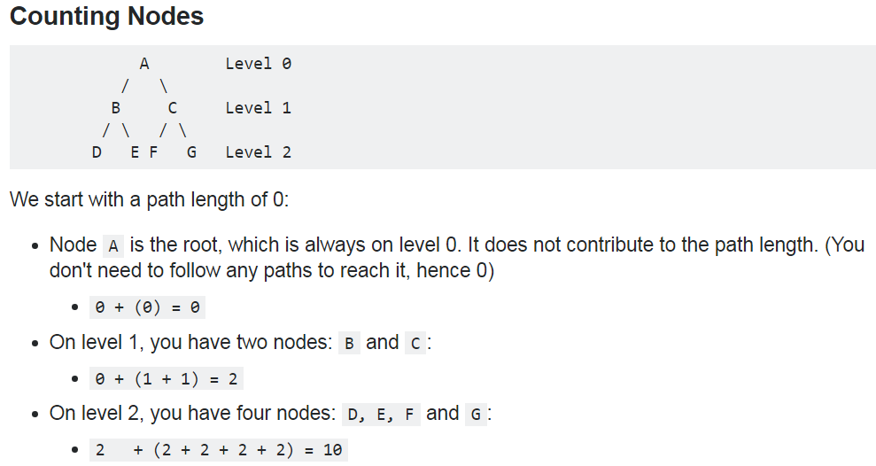
Q4: Path Length of a Tree-II

